Slide 1


Engineering Drawing
Module 3
Isometric Projection
Sheba Varghese
Assistant Professor,
Dept. Of Mechanical Engineering,
Room : A (310), KJSCE, Vidyavihar
Email : sheba@somaiya.edu

Slide 2

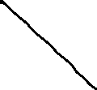







Introduction
Isometric projection is a type of an axonometric projection (or pictorial projection).
Isometric means ‘equal measure’.
In isometric projection,
all the mutually perpendicular plane surfaces of an object and the edges formed by these surfaces are equally inclined to a POP.
In isometric projection, only one view on a plane is drawn to represent the three dimensions of an object.
This provides a pictorial view with a real appearance.

Slide 3
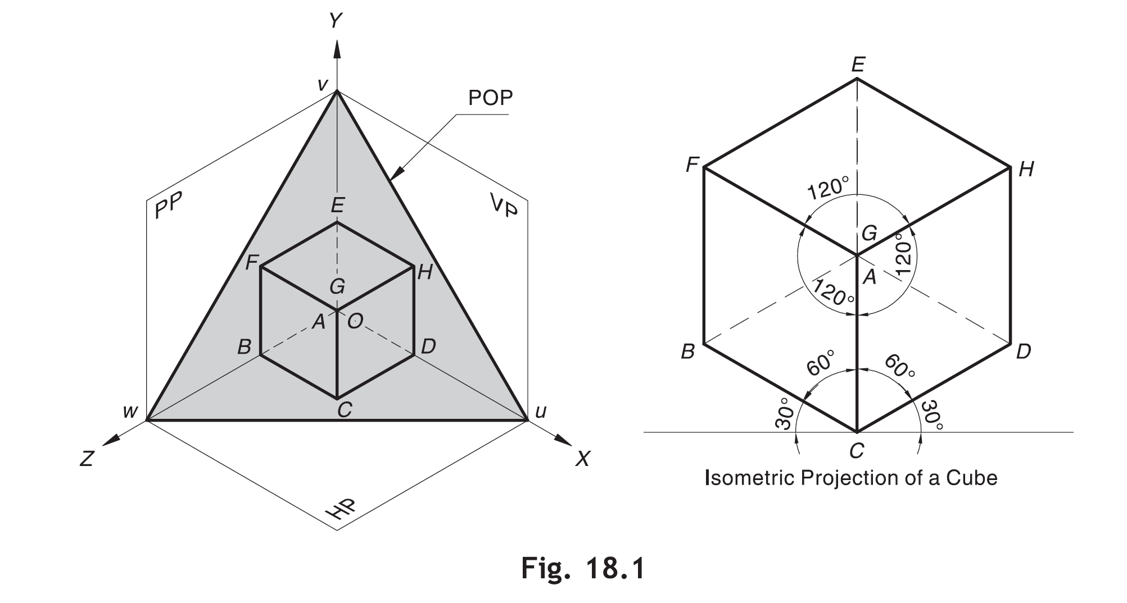








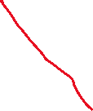








Principle of Isometric Projection
Consider a cube ABCDEFGH resting on one of its corners, say A, at origin ‘O’ and the body diagonal through that corner, i.e., AG, equally inclined to the three axes—X, Y and Z
POP (UVW) makes approximately 54°44’ to each RP.
AG is perpendicular to the plane UVW
UVW is called an isometric projection
It should be noted that, as all the edges of a cube are equally inclined to the POP, they get equally foreshortened in isometric projection. Thus, the isometric projection is smaller than the real object.

Slide 4
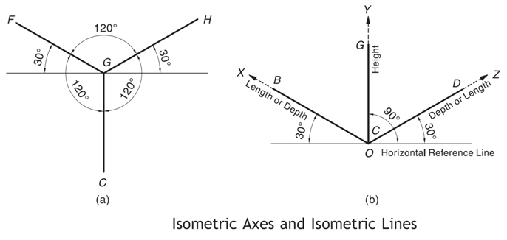
Terminology
Isometric axes: The three lines GH, GF and GC meeting at point G and making 120° angles with each other are termed isometric axes.
Isometric lines: The lines parallel to the isometric axes are called isometric lines or isolines. A line parallel to the X-axis may be called an x-isoline. So are the cases of y-isoline and z-isoline.

Slide 5
Terminology
Non-Isometric lines: The lines which are not parallel to isometric axes are called non-isometric lines or non-isolines.
Isometric planes: The planes representing the faces of the cube as well as other faces parallel to these faces are called isometric planes or isoplanes. Note that isometric planes are always parallel to any of the planes formed by two isometric axes.
Non-Isometric planes: The planes which are not parallel to isometric planes are called nonisometric planes or non-isoplanes (or non-isometric faces).
Origin or Pole Point: The point on which a given object is supposed to be resting on the HP or ground such that the three isometric axes originating from that point make equal angles to POP is called an origin or pole point.

Slide 6
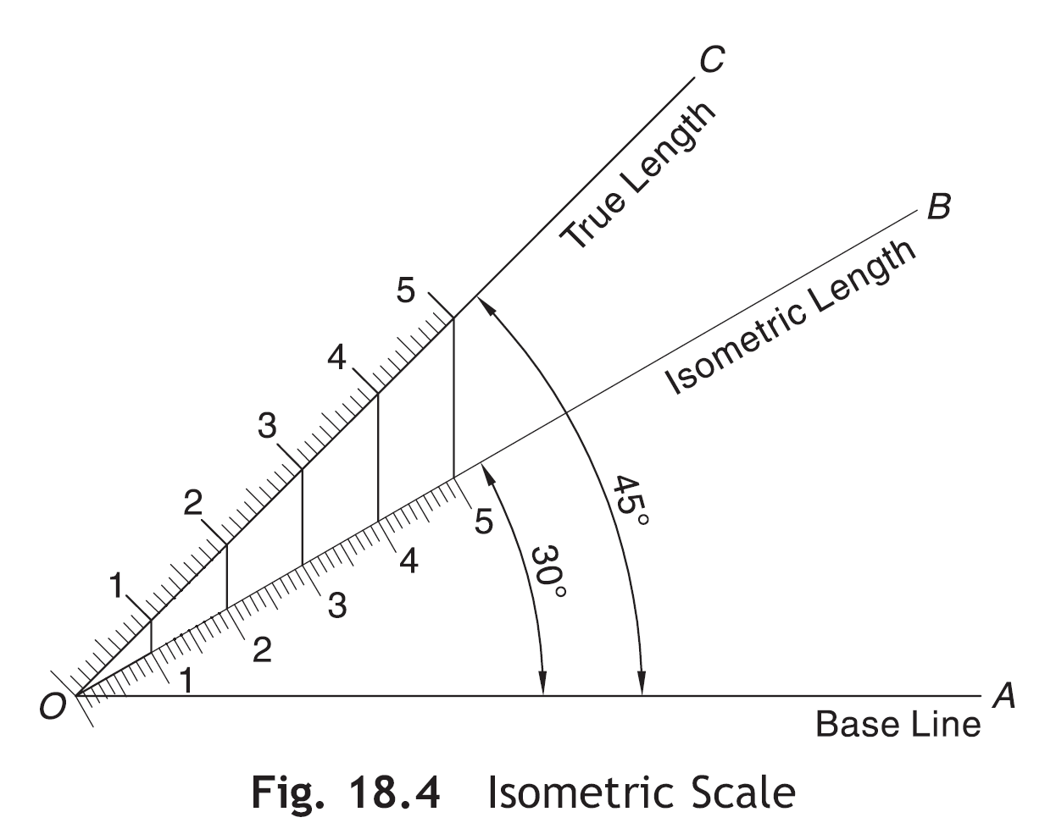
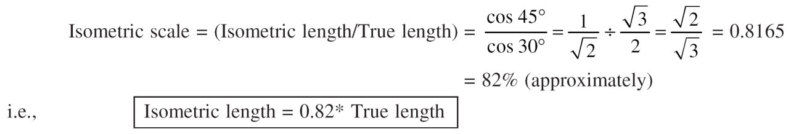










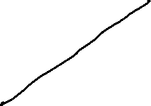



Isometric scale
The isometric projection appears smaller that the real object.
Because all the isometric lines get equally foreshortened.
The proportion by which isometric lines get foreshortened in an isometric projection is called isometric scale.
It is the ratio of the isometric length to the actual length.

Slide 7
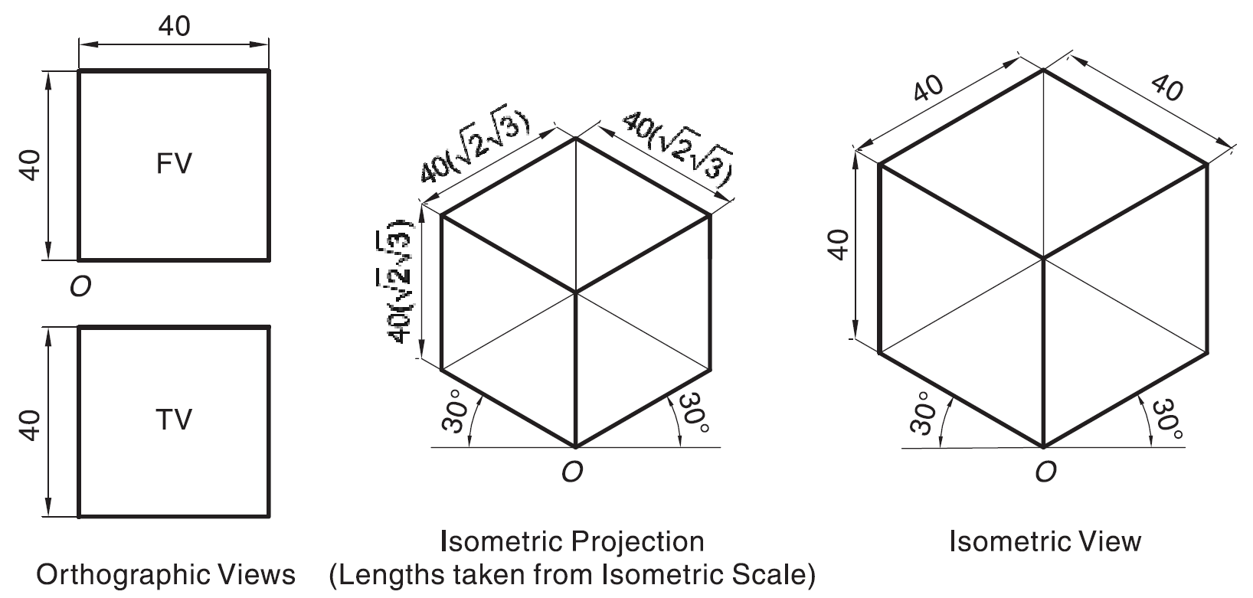


















Isometric Projections and Isometric Views
Isometric projection is often constructed using isometric scale which gives dimensions smaller than the true dimensions.
However, to obtain isometric lengths from the isometric scale is always a cumbersome task.
Standard practice is to keep all dimensions as it is. The view thus obtained is called isometric view or isometric drawing.
As the isometric view utilizes actual dimensions, the isometric view of the object is seen larger than its isometric projection.

Slide 8
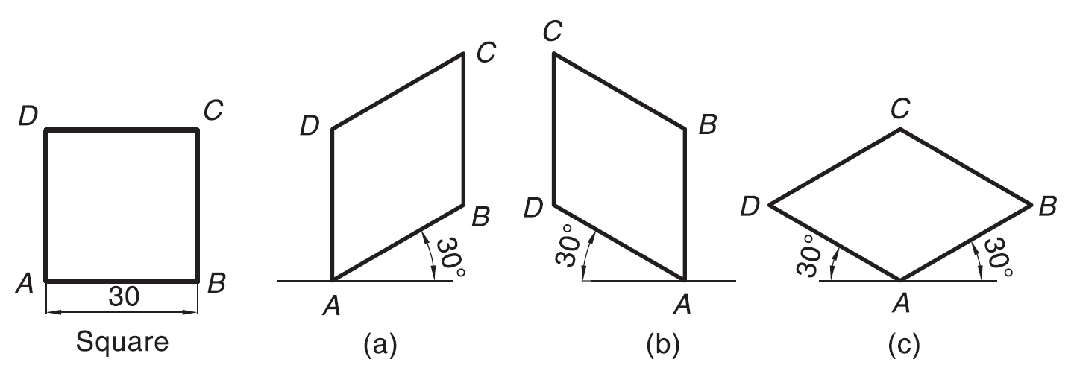
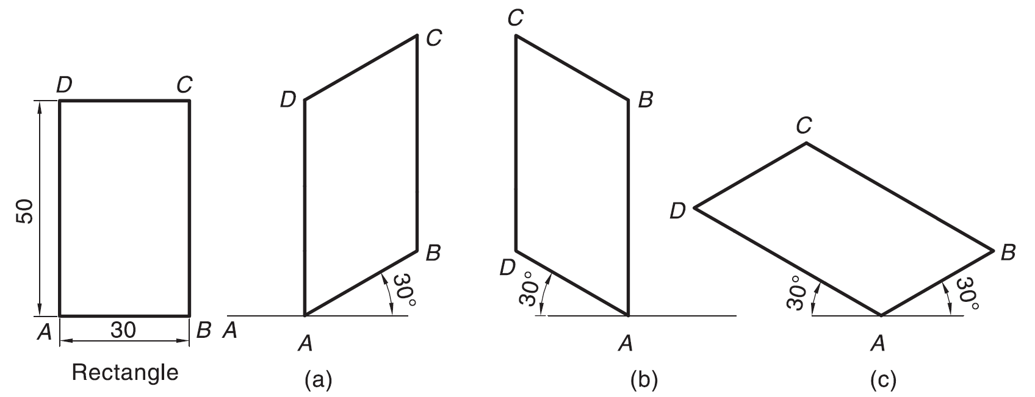
Isometric View: Rectangle/Square
H
D
RECTANGLE
D
A
D
A
L
L
C
D
C
A
B
C
B
B

Slide 9
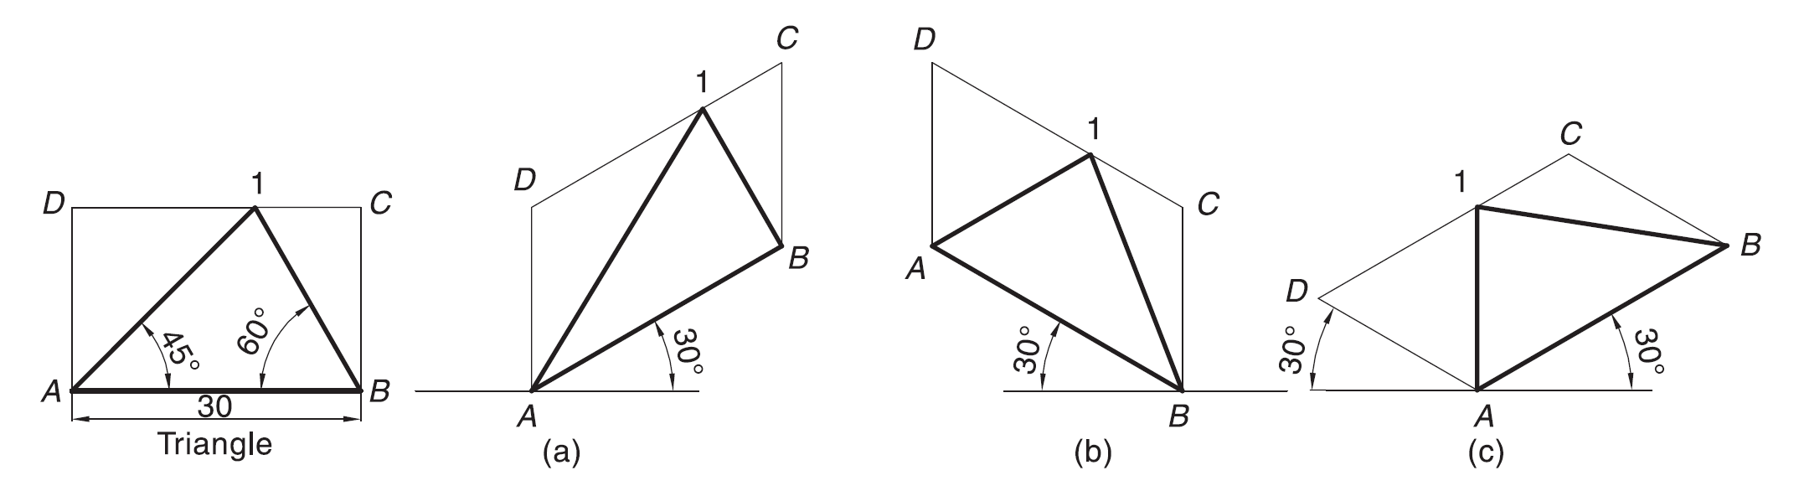
Isometric View: Triangle
B
H
TRIANGLE
3
B
1
B
1
L
3
L
A
D
A
3
1
2
A
2
2

Slide 10
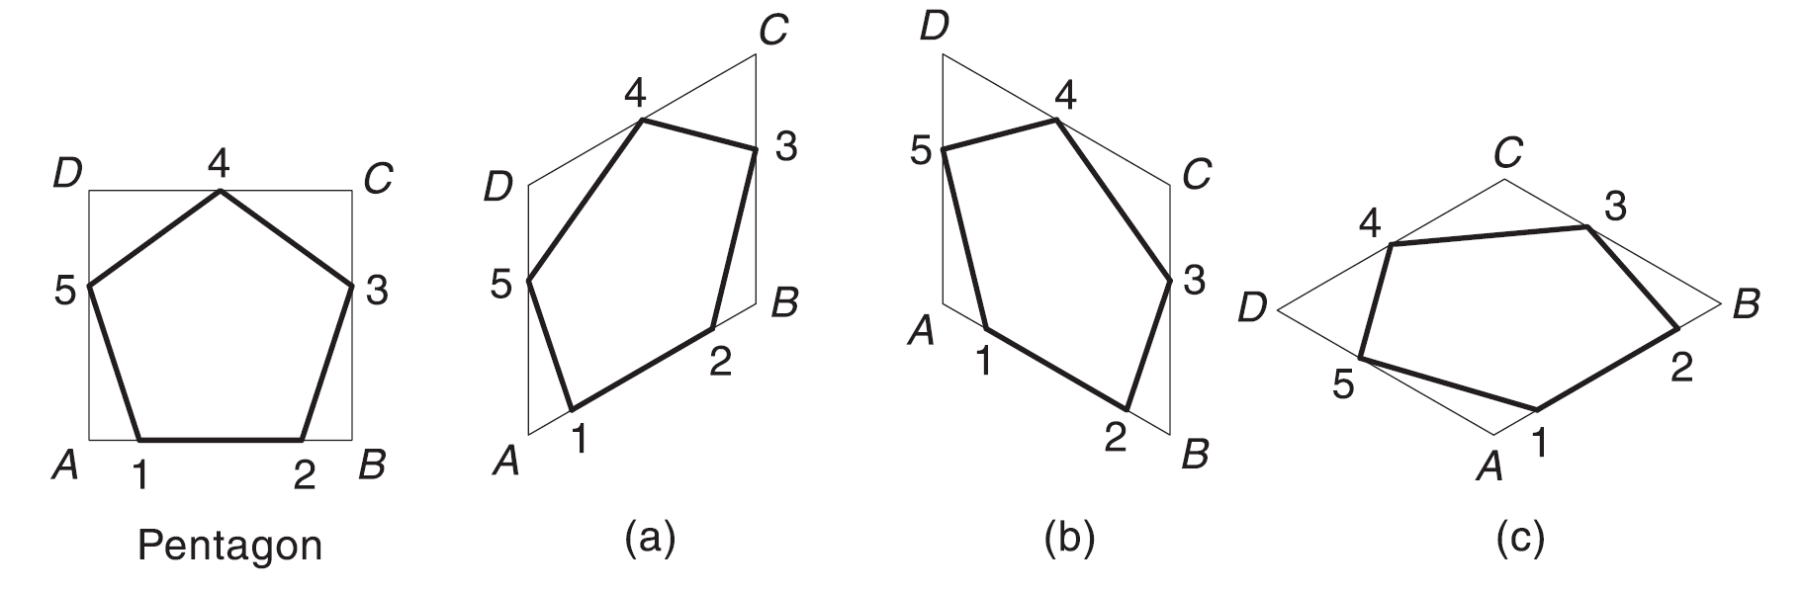
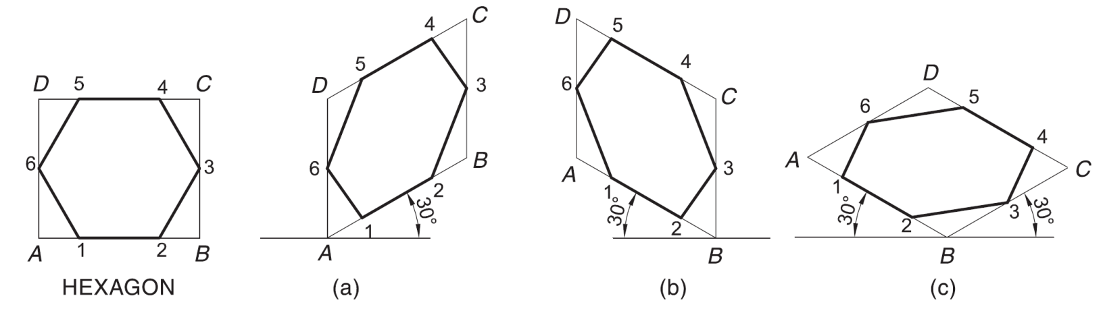
Isometric View: Pentagon/Hexagon
4
PENTAGON
H
E
1
E
4
1
D
4
E
D
A
D
A
D
L
L
1
3
3
A
C
C
2
B
3
B
B
C
2
2

Slide 11
Isometric View: Circle
A
B
2
2
4
A
B
3
4
D
3
C
1
D
C
1

Slide 12
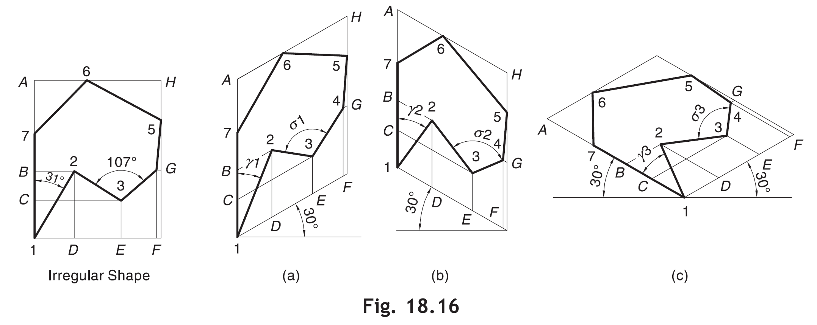
Isometric View: Irregular Shape
The isolines B–2, D–2, C–3, E–3, G–4, F–4, H–5, H–6 and A–7 has the same length as in original shape, e.g., B–2 in isometric = B–2 in irregular shape.
1. Non-isometric line can be located by its end points.
2. Similarly, an angle in orthographic view is never seen in its isometric.

Slide 13
Isometric View: Prism
ISOMETRIC VIEW OF
PENTAGONAL PRISM
LYING ON H.P.
Axis length
4
H
E
1
D
A
L
3
C
2
B
ISOMETRIC VIEW OF
HEXAGONAL PRISM
STANDING ON H.P.
Axis length

Slide 14
Isometric View: Pyramid
ISOMETRIC VIEW OF PENTAGONAL PYRAMID STANDING ON H.P. (Height is added from center of pentagon)
ISOMETRIC VIEW OF BASE OF PENTAGONAL PYRAMID STANDING ON H.P.
4
4
D
D
E
E
D
L
D
L
1
3
1
3
A
C
B
A
C
2
B
2

Slide 15
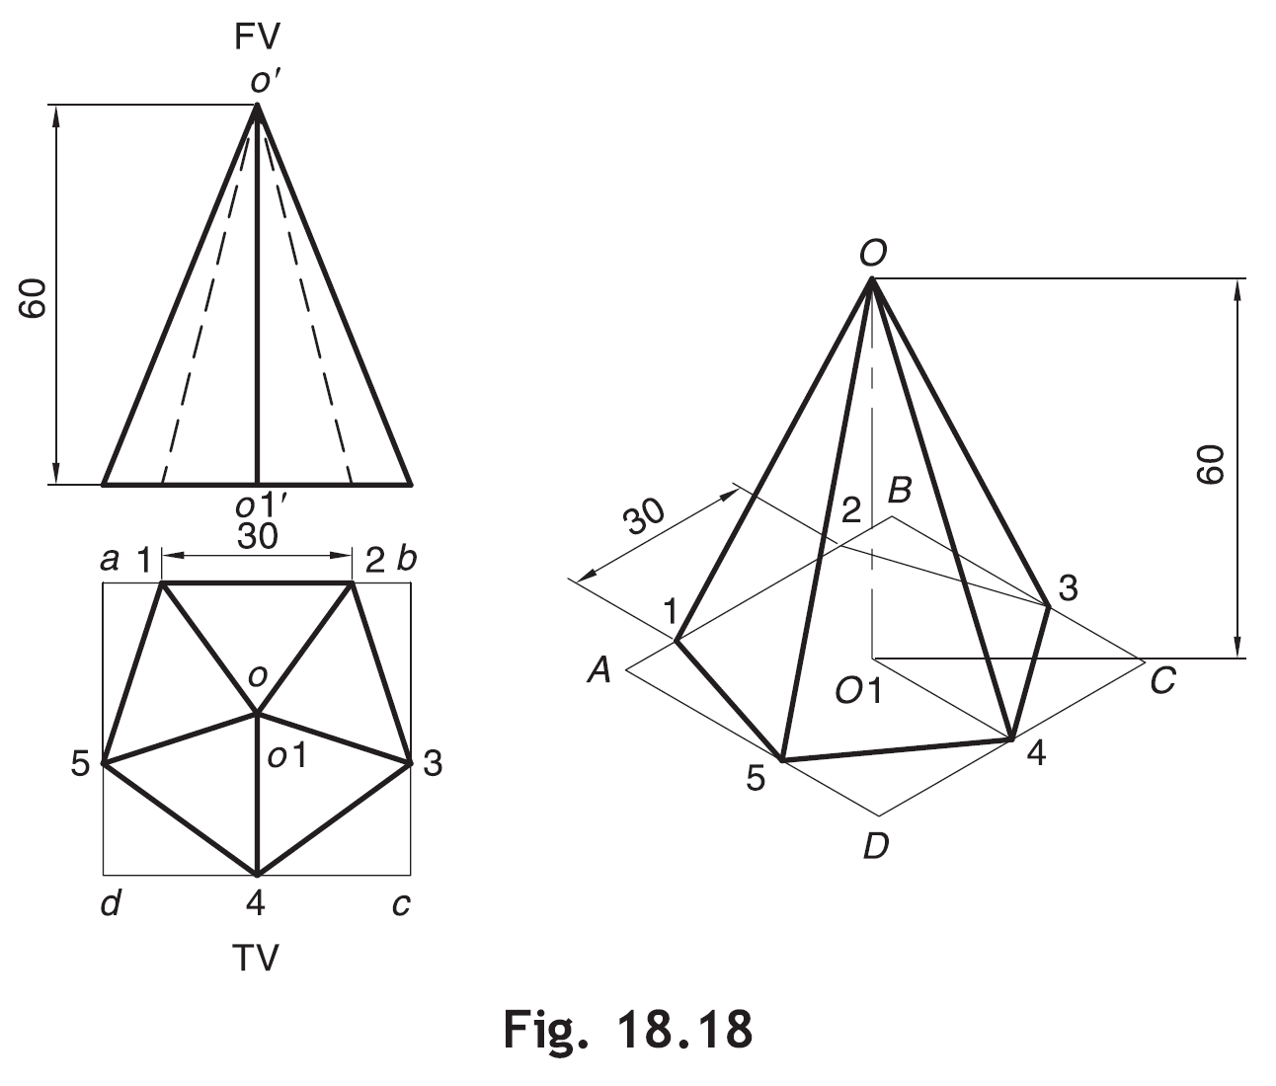
Isometric View: Pyramid

Slide 16
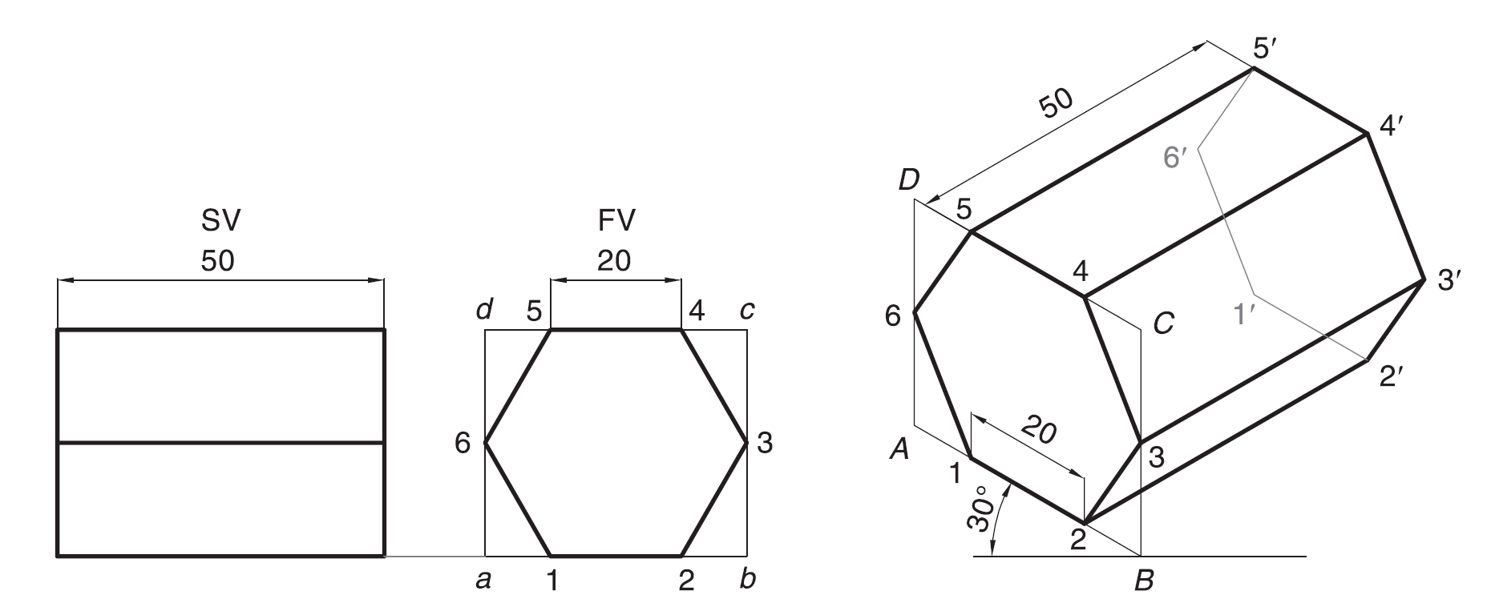
Isometric View: Prism

Slide 17
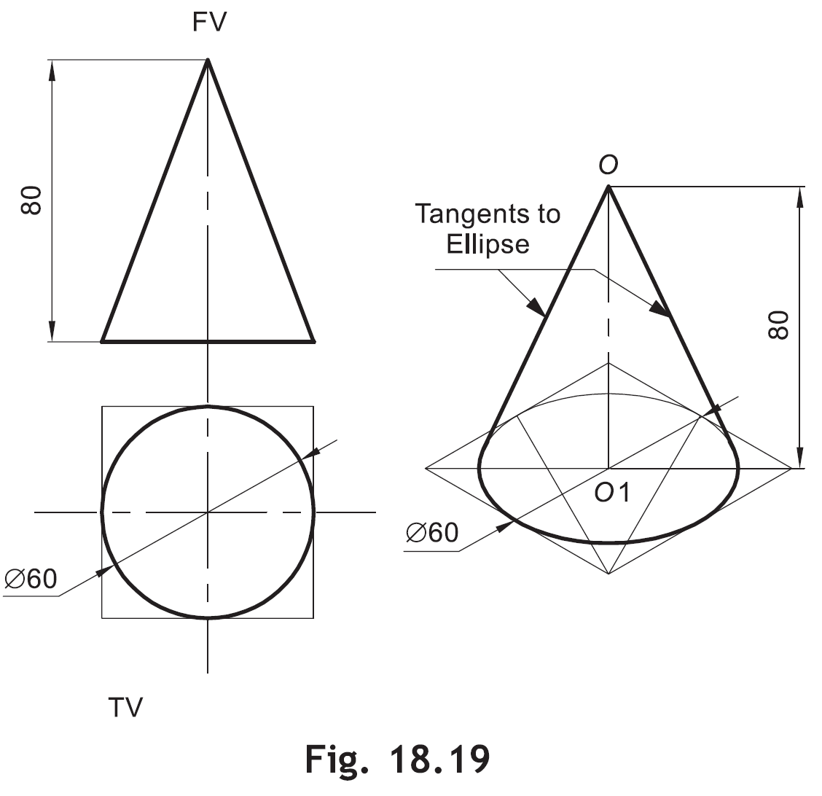
Isometric View: Cone
2
A
B
3
4
O
D
C
1

Slide 18
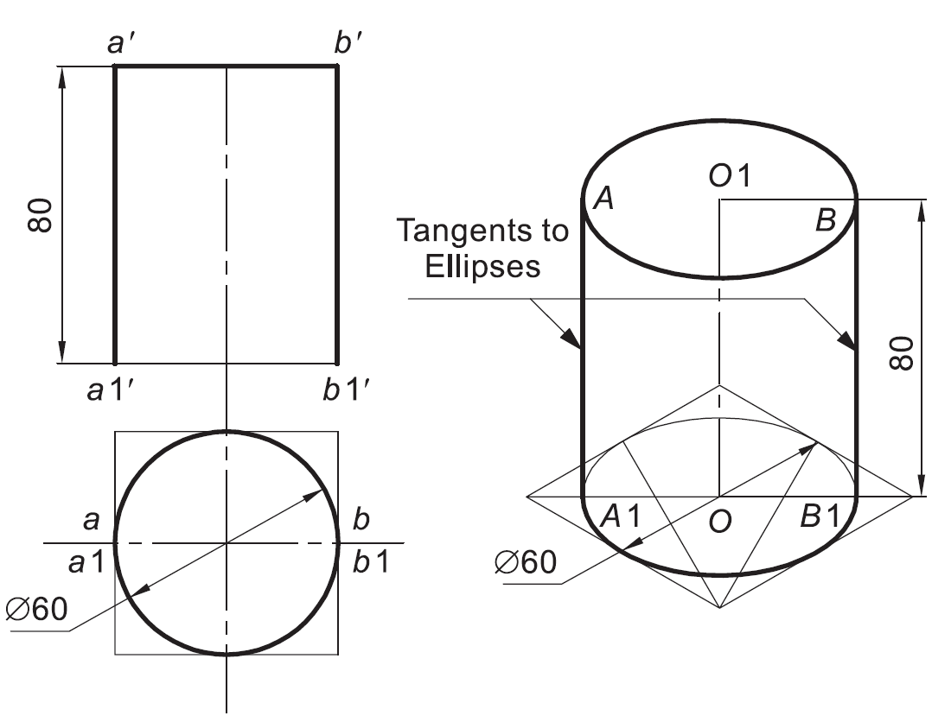
Isometric View: Cylinder
CYLINDER STANDING ON H.P.
CYLINDER LYING ON H.P.

Slide 19
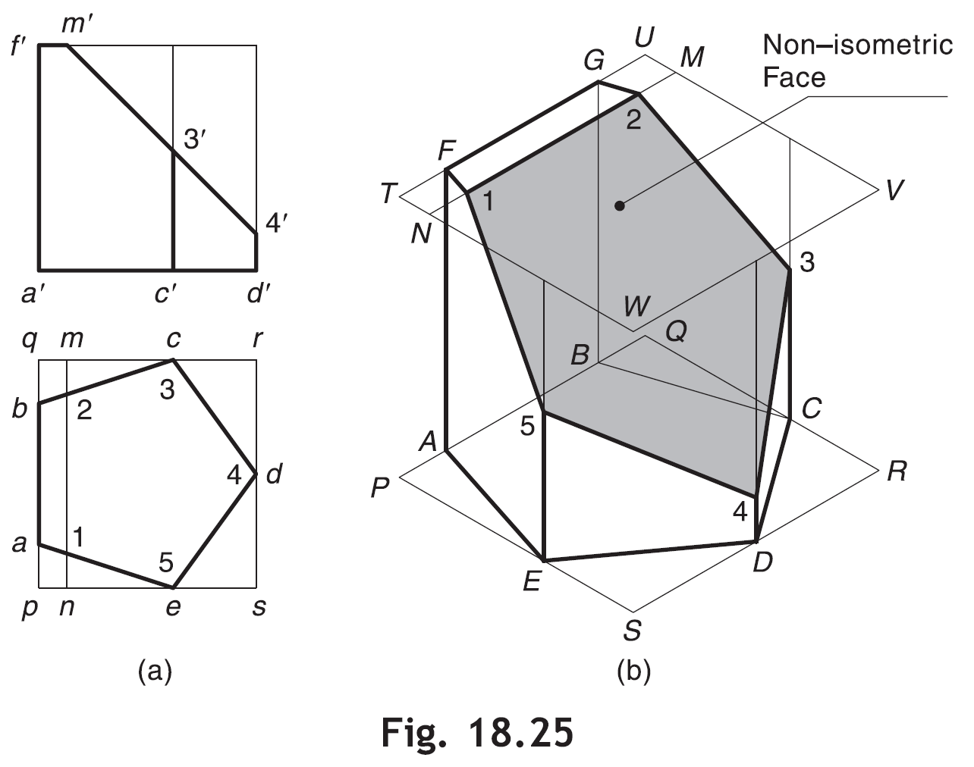
Solids with Non-Isometric Faces
C-3=E-5=c’-3’
D-4=d’-4’
M-N

Slide 20
Solids with Non-Isometric Faces
A SQUARE PYRAMID OF 40 MM BASE SIDES AND 60 MM AXIS IS CUT BY AN INCLINED SECTION PLANE THROUGH THE MID POINT OF AXIS AS SHOWN. DRAW ISOMETRIC VIEW OF SECTION OF PYRAMID.
3’
4’
4
1’
3
2’
X
Y
1
a
1
d
4
2
o
2
3
b
c

Slide 21
F.V. & T.V. of a solid are given. Draw it’s isometric view.
50
X
O
Y
20
25
O
25
20

Slide 22
F.V. & T.V. and S.V. of a solid are given. Draw it’s isometric view.
ORTHOGRAPHIC PROJECTIONS
FRONT VIEW
L.H.SIDE VIEW
20
20
x
20
y
O
50
20
30
20
20
20
O
TOP VIEW

Slide 23
F.V. and S.V. of a solid are given.
Draw it’s isometric view.
30 SQUARE
40
20
50
20
10
O
30
F.V.
60
S.V.
O

Slide 24
F.V. & T.V. of a solid are given. Draw it’s isometric view.
FV
40
10
O
30 D
45
10
50
O
80
TV

Slide 25
F.V. and S.V. of a solid are given.
Draw it’s isometric view.
HEX PART
20
30
20
40
20
O
50
20
15
O
30
100
60

Slide 26
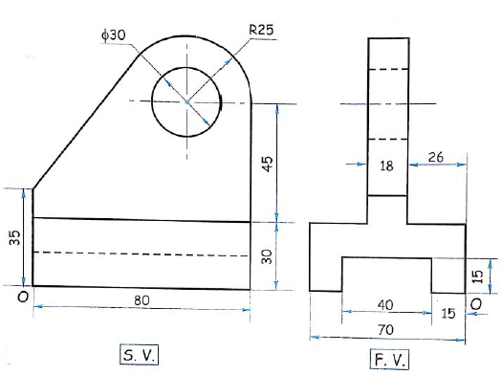
Isometric Drawing
Problem 1

Slide 27
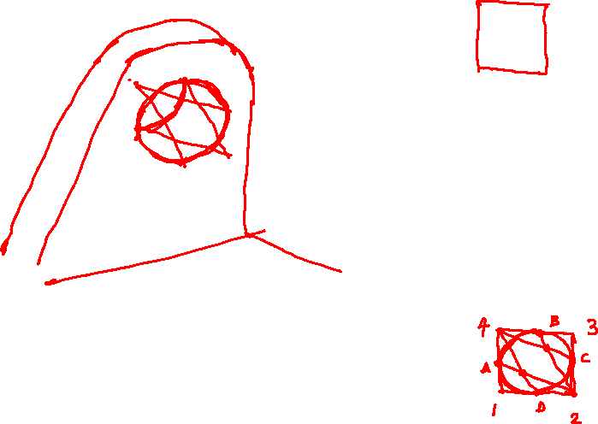





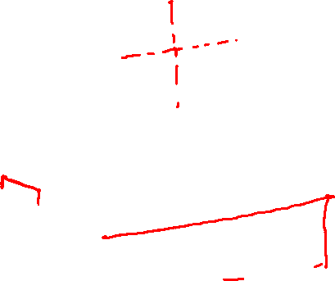



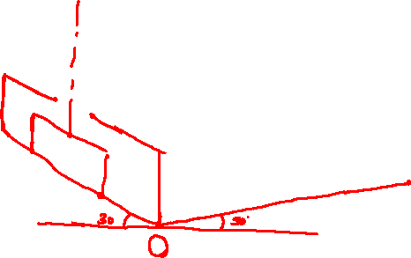

Isometric Drawing
Problem 1

Slide 28
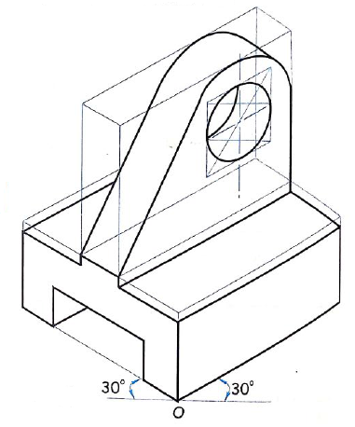
Solution

Slide 29
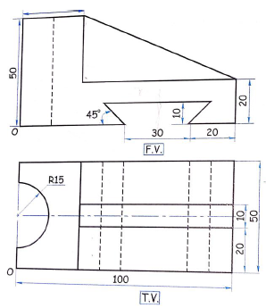
Problem 2

Slide 30
Problem 2

Slide 31
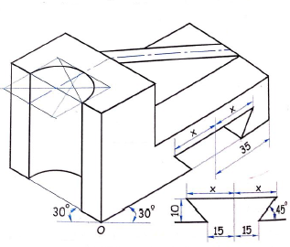
Solution

Slide 32
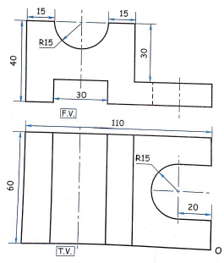
Problem 3

Slide 33
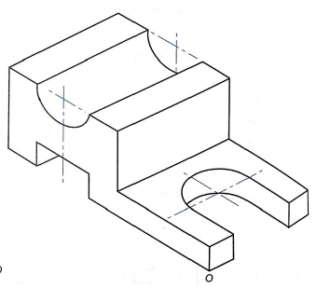
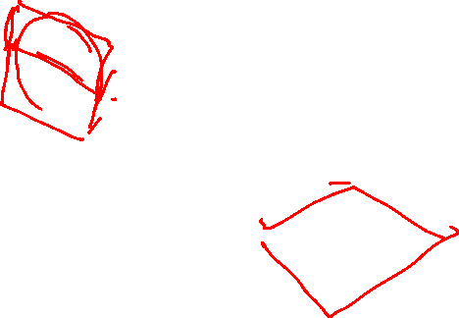
Problem 3
Solution

Slide 34
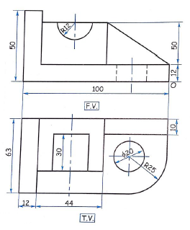
Problem 4
Solution

Slide 35
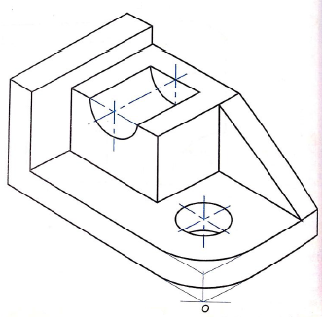

Problem 4
Solution

Slide 36
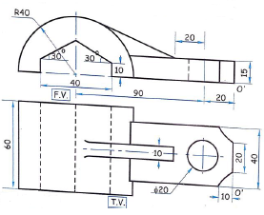
Problem 5

Slide 37
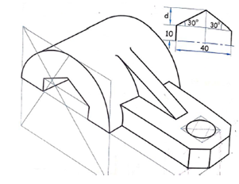
Problem 5
Solution

Slide 38
F.V. and S.V. of a solid are given. Draw it’s isometric view.
10
25
15
25
40
10
25
25
O
O
80
25
F.V.
S.V.

Slide 39
F.V. & T.V. of a solid are given. Draw it’s isometric view.
45⁰
30
FV
40
X
Y
O
30 D
40
TV
15
O
40

Slide 40
F.V. & T.V. of an object are given. Draw it’s isometric view.
20
40
F.V.
30
10
X
O
Y
10
30
10
30
O
80
T.V.

Slide 41
F.V. and S.V. of a solid are given.
Draw it’s isometric view.
30
20
10
20
10
15
15
O
30
15
15
O
X
Y
50
F.V.
LEFT S.V.

Slide 42
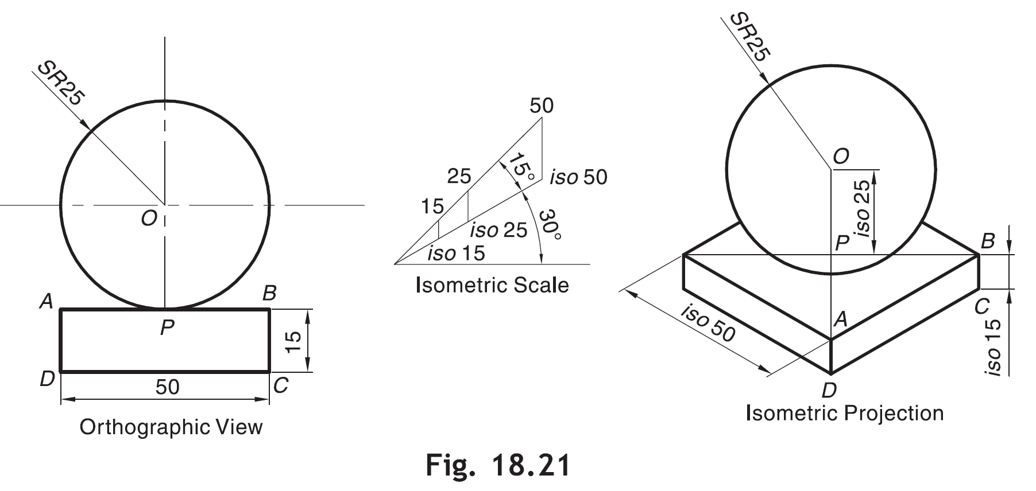
Isometric Projections: Sphere
Radius of sphere remains same in isometric projection
Use isometric scale and draw solid attached to sphere and distance O-P
Identify center O and draw a circle of radius=radius of sphere

Slide 43
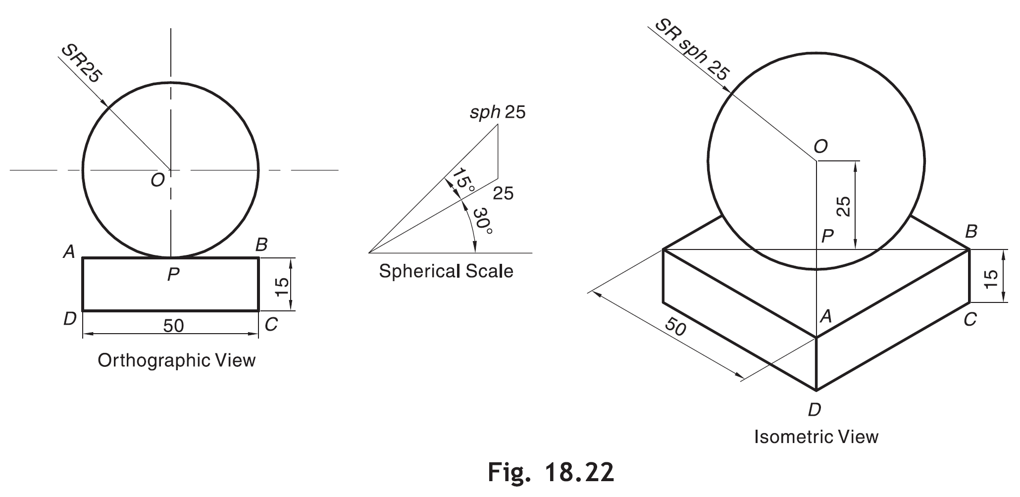
Radius of sphere in isometric view is more than actual radius of sphere

